Slide 1
Discrete Mathematics
South China University of Technology
1

Slide 2
Chapter 9. Graphs
Planar Graph
Section 9.7
2

Slide 3
Contents
1
Introduction of Planar Graph
2
Euler’s Formula
3
Kuratowski’s Theorem
3

Slide 4
Introduction of Planar Graph
4

Slide 5
In this section we will study the question of whether a graph can be drawn in the plane without edges crossing?
In particular, we will answer the houses-and-utilities problem.

Slide 6
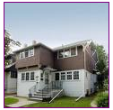
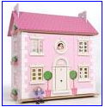

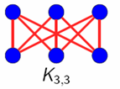



Planar graph without edges crossing ?

Slide 7
Application of planar graph
Planarity of graphs play an important role in the design of electronic circuits.
We can model a circuit with a graph by representing components of the circuit by vertices and connections between them by edges.
We can print a circuit on a single board with no connections crossing if the graph representing the circuit is planar.

Slide 8
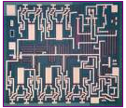

Application of planar graph
When this graph is not planar, we must turn to more expensive options. We need construct the circuit using multiple layer.

Slide 9
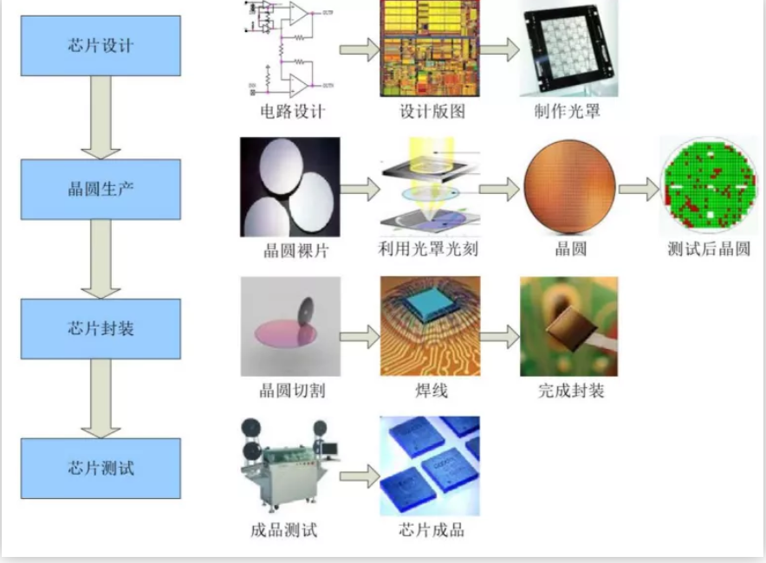

Slide 10
Definition 1
A graph is called planar if it can be drawn in the plane without any edges crossing
(where a crossing of edges is the intersection of the lines or arcs representing them at a point other than their common endpoint).
Such a drawing is called a planar representation of the graph.

Slide 11
Example 1
K4 is planar because it can be drawn without crossing.

Slide 12
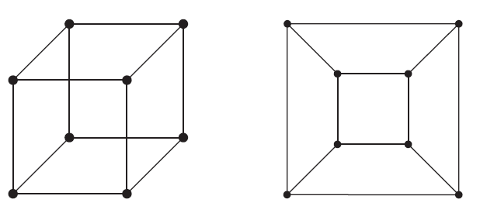
Example 2
Q3 is planar because it can be drawn without crossing.

Slide 13
Example 3
v1
v2
v3
v4
v5
v6

Slide 14
Example 3 Analysis
v1
v2
v3
v4
v5
v6
In any planar representation, the vertices v1 and v2 must be connected to both v4 and v5.

Slide 15
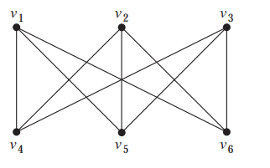
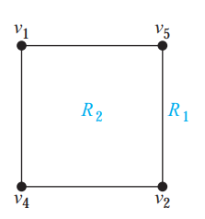
Example 3 Analysis
These four edges form a curve that splits the plane into two regions R1 and R2.

Slide 16
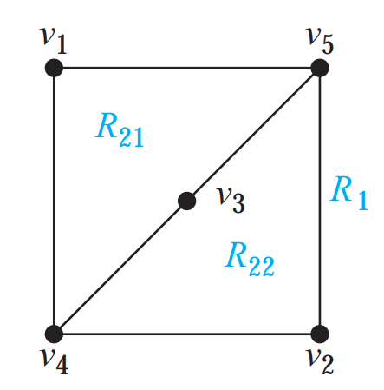
Region
The vertex v3 in either R1 or R2. When v3 is in R2, its incident edges separate R2 into R21 and R22

Slide 17
v1
v5
v6
v3
R21
R1
R2
v6
R22
v6
v4
v2
Whenever v6 is in R1, R21 or R22, its incident edges cannot be draw without crossing.

Slide 18
Planar graph without edges crossing ?
Therefore, K_{3,3} is not planar.

Slide 19
Euler’s Formula
19
19

Slide 20
A planar representation of a graph splits the plane into regions, including an unbounded region.
R4
R2
R3
R6
R1
R5

Slide 21
R4
R2
R3
R6
R1
R5
Euler showed that all planar representations of a graph split the plane into the same number of regions.
He found a relation among the number of regions, the number of vertices, and the number of edges of a planar graph.

Slide 22
Euler’s Formula
Theorem 1 (necessary condition): Let G be a connected planar simple graph with e edges and v vertices. Let r be the number of regions in a planar representation of G. Then
r + v-e = 2.
Proof :
We prove it by induction.

Slide 23
Example 4
Suppose that a connected planar simple graph has 20 vertices, each of degree 3.
How many regions does a representation of this planar graph split the plane?
Because 2e = 20 * 3 =60, e =30.
Hence, r = e – v + 2 = 30 - 20 +2 = 12.

Slide 24
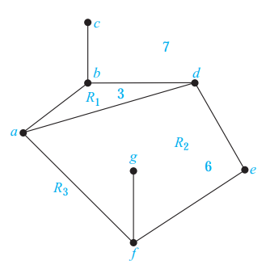
由极短回路所包围的部分，其内部无节点，但可以有边，这样的部分，就叫做region

Slide 25

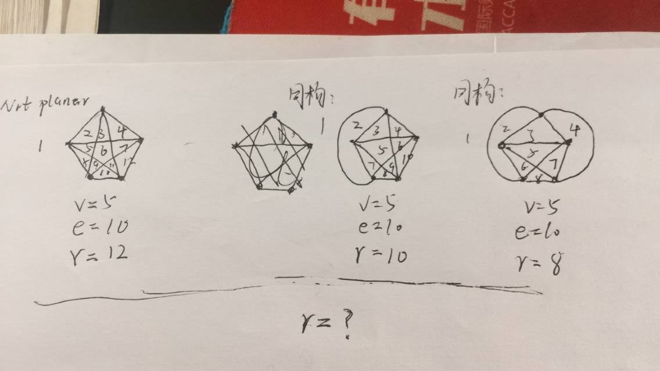

Slide 26
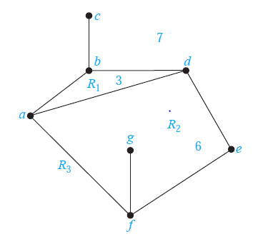
The degree of a region is length of the shortest circuit walking along its every edge (called boundary). When an edge occurs twice on the boundary, it contributes two to the degree.

Slide 27
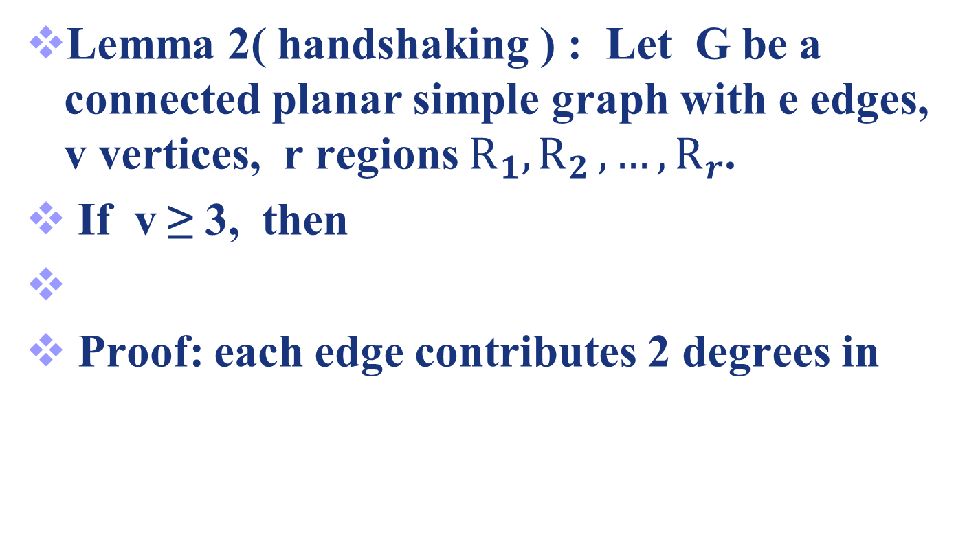
Sum of region degree and number of edges
Lemma 2( handshaking ) : Let G be a connected planar simple graph with e edges, v vertices, r regions $R_{1}{,R}_{2},…,R_{r}$.
If v ≥ 3, then
Proof: each edge contributes 2 degrees in

Slide 28

Region degree
Lemma 1: Let G be a connected planar simple graph with e edges, v vertices, r regions $R_{1}{,R}_{2},…,R_{r}$. If v ≥ 3, then

Slide 29
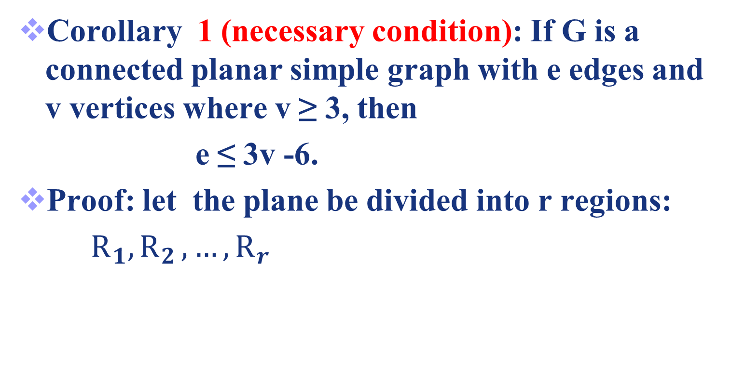
Corollary 1
Corollary 1 (necessary condition): If G is a connected planar simple graph with e edges and v vertices where v ≥ 3, then
e ≤ 3v -6.
Proof: let the plane be divided into r regions:
$R_{1}{,R}_{2},…,R_{r}$

Slide 30
Proof

Slide 31
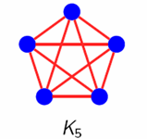
Example 5
Show that K5 is nonplanar using Corollary 1.
Solution: The graph K5 has 5 vertices and 10 edges. Thus, e = 10 and 3v – 6 = 9.
Hence, e ≤3v – 6 is not satisfied.
Therefore, K5 is not planar.

Slide 32
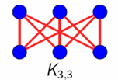
Another Example
The graph K3,3 has 6 vertices and 9 edges.
e = 9 ≤ 12 =3 * 6 – 6 is satisfied.
However, the satisfied e ≤3v – 6 does not imply that a graph is planar.

Slide 33
Corollary 2
Corollary 2 (necessary condition): : If G is a connected planar simple graph, then
Proof: we prove it by contradiction.
Assuming ,
That is, .
However,

Slide 34
Example
Question: Q₆ is planar?
NO!!!!

Slide 35

Lemma 3: Let G be a connected planar simple graph with e edges, v vertices, r regions $R_{1}{,R}_{2},…,R_{r}$. If v ≥ 3, and no circuits of length 3 then

Slide 36
Corollary 3
Corollary 3 (necessary condition): If G is a connected planar simple graph has e edges and v vertices with v ≥ 3 and no circuits of length 3, then
e ≤ 2v - 4.

Slide 37
Proof

Slide 38
Another Example
The graph K3,3 has 6 vertices and 9 edges.
e = 9 and 2v-4 = 8 .
Corollary 3 shows that K3,3 is nonplanar.

Slide 39
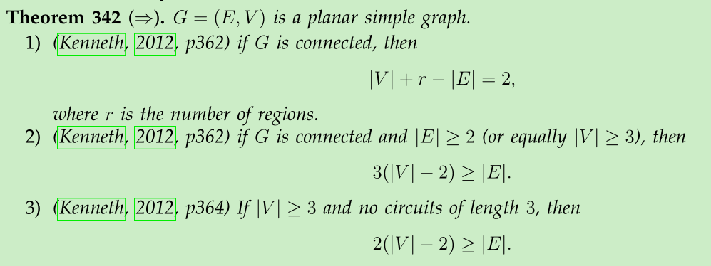
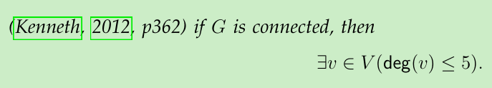
summary of necessary conditions

Slide 40
Kuratowski’s Theorem
40
40

Slide 41
Kuratowski’s Theorem
If a graph is planar, so will be any graph obtained by removing an edge {u, v} and adding a new vertex w with {u, w} and {w, v}.
This operation is called an elementary subdivision. 初等细分
u
u
w
v
v

Slide 42
Kuratowski’s Theorem
The graphs G1=<V1, E1> and G2=<V2, E2> are called homeomorphic (同胚) if they can be obtained from the same graph by a sequence of elementary subdivisions.

Slide 43
Homeomorphic Graphs
a
G1
a
G2
b
b
f
h
g
c
e
c
e
d
d
a
G3
b
G2 and G3 are obtained from G1 by elementary subdivisions.
k
i
j
g
c
e
d

Slide 44
elementary subdivisions and subgraph.
a
G1
a
G2
b
b
f
h
g
c
e
c
e
d
d
G1 ⊆ G2 ?

Slide 45
Theorem 2
A graph is nonplanar ⇔ it contains a subgraph homeomorphic to K3,3 or K5.
Corollary 4,5
A graph is planar ⇔ it does not contains any subgraph homeomorphic to K3,3 or K5.
A graph is planar ⇒ it does not contains K3,3 or K5 as subgraph.

Slide 46
Example 7
a
b
j
k
h
c
i
d
f
e
g
G
G is planar?

Slide 47
Example 7
a
b
a
b
j
k
h
c
c
i
d
i
f
e
g
g
G
H
Step 1：delete vetexes of degree 2。G and H are homeomorphic

Slide 48
Example 7
a
b
a
b
c
c
i
i
g
g
H
J
Step 2：delete redundant edges. H ⊇ J

Slide 49
Example 7
a
b
a
b
j
c
i
c
g
k
h
H
i
d
f
e
g
G
c
G is nonplanar.
i
g
K5

Slide 50
Example 8
a
e
f
b
j
g
i
h
d
c
(1)
the Petersen graph is planar?

Slide 51
Example 8
a
f
e
f
b
j
g
j
g
i
h
i
h
d
c
d
c
(2)
(1)
Step 1：delete vetex b and its edges
(1) ⊇ (2)

Slide 52
Example 8
a
e
f
e
f
j
g
j
i
h
i
h
d
c
d
(2)
(3)
Step 2：delete vetexes of degree 2。 (2) and (3) are homeomorphic

Slide 53
f
e
j
i
h
d
(3)
(4)
(3) is a Bipartite Graph with vertex of degree 3
Graph (3) is isomorphic to Graph (4)

Slide 54
Homework
5, 9, 12

Slide 55
End of Section 9.7
Click to edit company slogan .
55

